Slide 1
NPRB Arctic IERP Synthesis Chukchi BTS design evaluation updates
Zack Oyafuso, Lewis Barnett, Margaret Siple, Dan Cooper, Stan Kotwicki
AFSC RACE Groundfish Assessment Program
9 March 2023
Notes:
From GAP, worked on the restratification of the Gulf of Alaska
Applied that workflow to the Chukchi Sea in anticipation for a potential bottom trawl survey in the area
Unlike the Gulf or the Bering sea, catch and effort data to use as planning data for the survey is not as plentiful in the Chukchi, maybe a handful of years in the past 10 years.
Here are what some of the distributions look like for representative taxa for two types of trawls, a smaller mesh beam trawl in green and a larger mesh otter trawl in blue.
We fitted these distributions and simulated populations so we could compare and evaluate different types of survey designs
Simple random, stratified, and fixed-grid systematic design similar to what has been done in the Chukchi and in the Bering Sea shelf surveys.
When we simulated surveys, we evaluated over a range of sampling effort on the x-axis, the precision we get from the three designs for the plot on the left, and then the uncertainty of the precision estimate on the right. Uncertainty of the CV estimate is a really important metric for us on the survey team because the CV of a survey is used as a comparable metric of survey quality. In some stock assessments, the survey CVs are used as weights, so we want make sure that these estimates of CV are reliable. This is an example for Alaska plaice.
A common trend we see is that of the three designs, the systematic design (blue) often has a lower level of CV compared to the randomized designs (black and gold) but with the tradeoff of higher uncertainty and bias than the randomized designs.
Between the two randomized designs, stratification often leads to lower CV than a simple random design when we compare the black line with the gold line, with no real difference in the uncertainty/reliability of the CV estimate. So the punchline with this plot is that with stratification, there is an improvement in our precision compared to a simple random design and our estimates of precision are still robust.

Slide 2
Chukchi Bottom Trawl Surveys
In anticipation of more ecosystem monitoring in the Chukchi
Opportunity to evaluate survey designs of bottom trawl surveys
Larger mesh otter trawl
Smaller mesh beam trawl
Historical surveying in the region used a fixed-grid systematic design
Do randomized designs provide more robust estimates of abundance and precision?

Slide 3
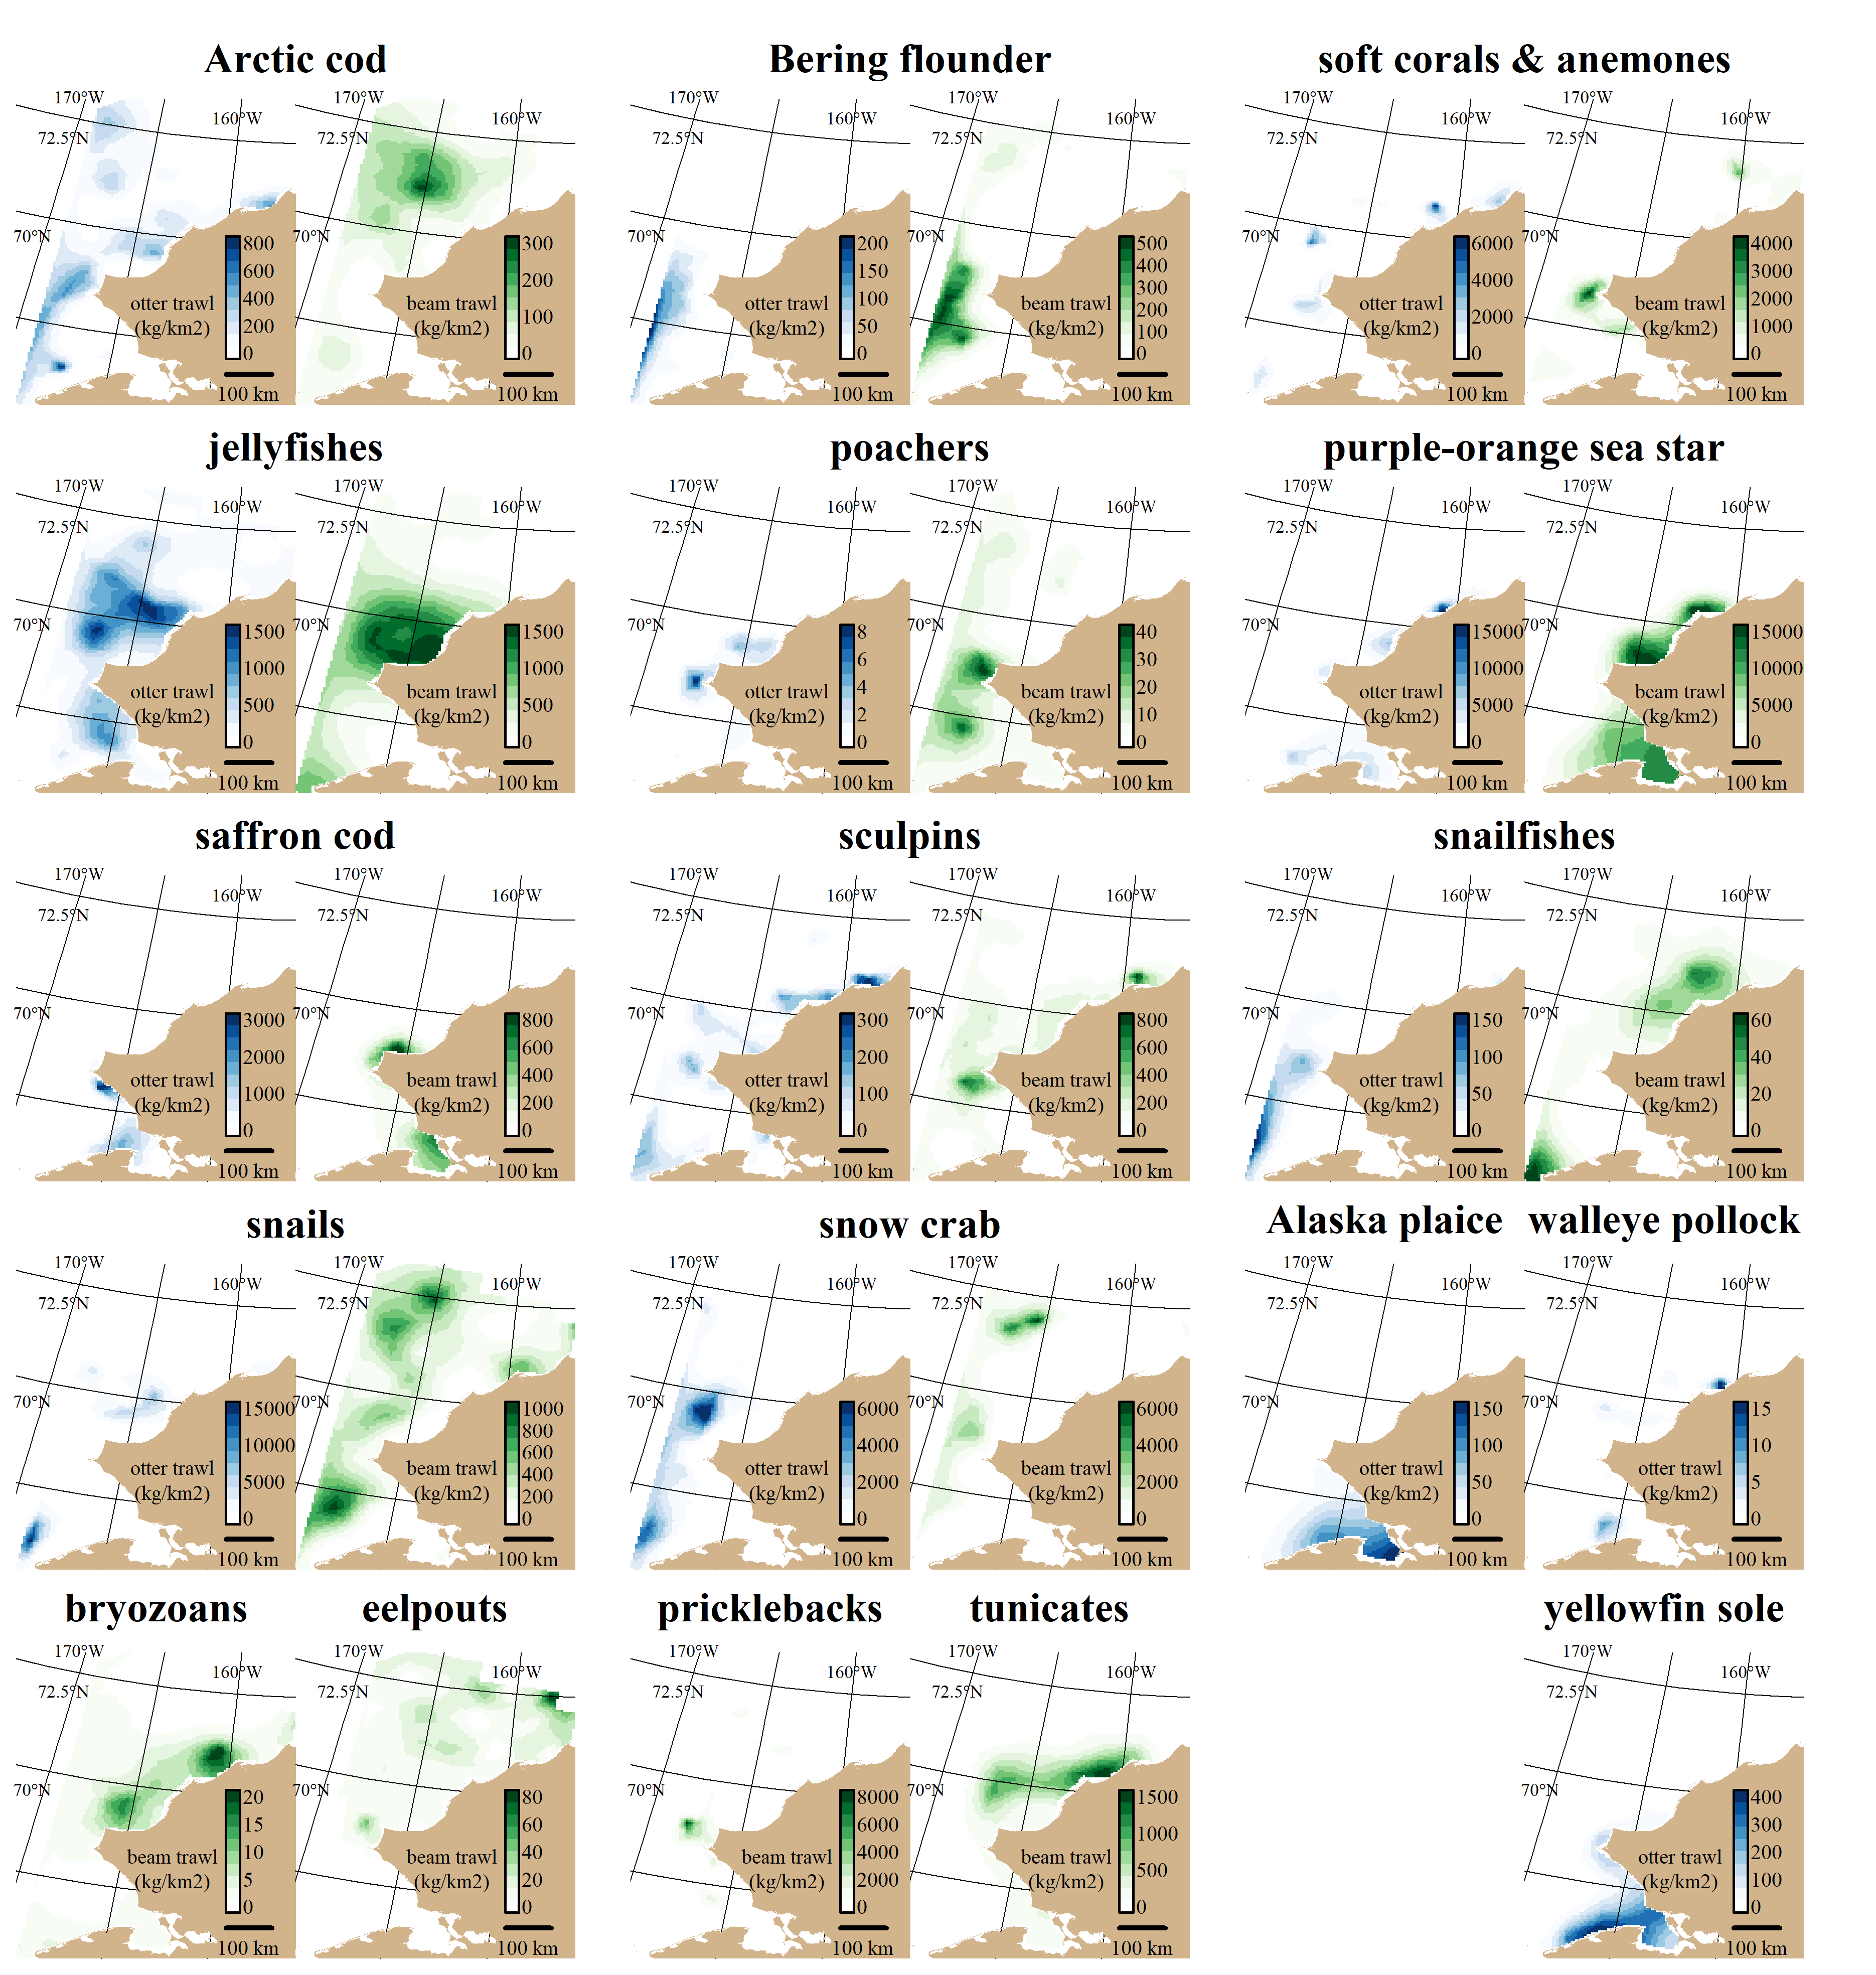

Slide 4
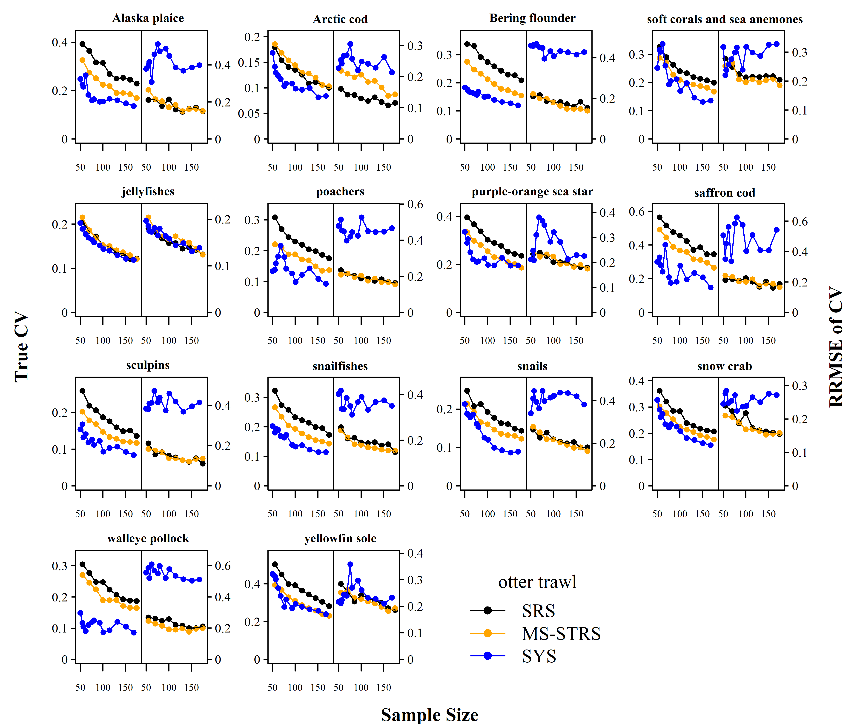
Uncertainty/Bias of CV
True CV
Total Effort (stations)

Slide 5
Next Steps
Journal submission
Outreach materials
Contact
Zack Oyafuso (zack.oyafuso@noaa.gov)
GitHub repo: zoyafuso-NOAA/chukchi_survey_evaluation

Slide 7
